Slide 1
ROADMAP - Concurrency
Key terms
Principles of concurrency :
Requirement of mutual exclusion
Semaphores

Slide 2
Concurrency
The central themes of operating system design are all concerned with the management of processes and threads:
Multiprogramming:
The management of multiple processes within a uniprocessor system.
Multiprocessing:
The management of multiple processes within a multiprocessor.
Distributed processing:
The management of multiple processes executing on multiple, distributed computer systems.
Concurrency: It is a property of systems in which several computations are executing simultaneously, and potentially interacting with each other.
It means managing the interaction of all of the processes.

Slide 3
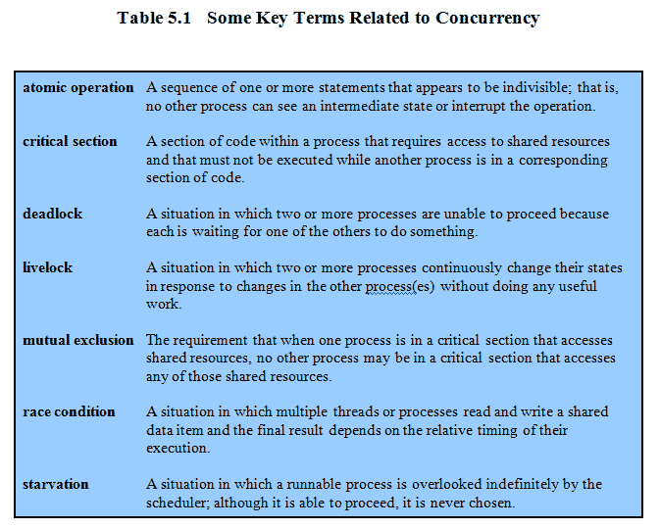
KEY TERMS

Slide 4
Live Lock
A thread often acts in response to the action of another
thread.
If the other thread's action is also a response to the
action of another thread, then live lock may result.
As with deadlock, livelocked threads are unable to make further progress.
However, the threads are not blocked — they are simply too busy responding to each other to resume work.
E.g. :- This is comparable to two people attempting to pass each other in a corridor:
A moves to his left to let B pass,
While B moves to his right to let A pass.
Seeing that they are still blocking each other,
A moves to his right, while B moves to his left.
They're still blocking each other, so..

Slide 5
A Simple Example
void echo()
{
chin = getchar();
chout = chin;
putchar(chout);
}
A program that will provide a character echo procedure;
input is obtained from a keyboard one keystroke at a time.
Each input character is stored in variable chin.
It is then transferred to variable chout
and finally sent to the display.
Any program can call this procedure repeatedly to accept user input and display it on the user’s screen.
Now consider that we have a single-processor multiprogramming system
The user can jump from one application to another, and each application uses the same keyboard for input and the same screen for output.
Notes:
A program that will provide a character echo procedure;
input is obtained from a keyboard one keystroke at a time.
Each input character is stored in variable chin.
It is then transferred to variable chout
and finally sent to the display.
Any program can call this procedure repeatedly to accept user input and display it on the user’s screen.
Now consider that we have a single-processor multiprogramming system supporting a single user.
The user can jump from one application to another, and each application uses the same keyboard for input and the same screen for output.
Each application needs to use the procedure echo,
So it makes sense for it to be a shared procedure that is loaded into a portion of memory global to all applications.
Thus, only a single copy of the echo procedure is used, saving space.

Slide 6
A Simple Example: On a Multiprocessor
Process P1 Process P2
. .
chin = getchar(); .
. chin = getchar();
chout = chin; chout = chin;
putchar(chout); .
. putchar(chout);
. .
The result is that the character input to P1 is lost before being displayed,
and the character input to P2 is displayed by both P1 and P2.
Notes:
The result is that the character input to P1 is lost before being displayed,
and the character input to P2 is displayed by both P1 and P2.

Slide 7
ROADMAP - Concurrency
Key terms
Principles of concurrency :
Requirement of mutual exclusion
Semaphores

Slide 8
SEMAPHORE
What operations can be performed on a semaphore?
Semaphore:
A semaphore is an integer value used for signalling among processes.
Only three operations may be performed on a semaphore, all of which are atomic:
1. Initialize:-
A semaphore may be initialized to a nonnegative integer value.
2.Decrement (semWait):- // To receive a signal
The semWait operation decrements the semaphore value.
If the value becomes negative, then the process executing the semWait is
blocked.
Otherwise, the process continues execution.
3. increment (semSignal):- // To transmit a signal
The semSignal operation increments the semaphore value.
If the resulting value is less than or equal to zero, then a process blocked
by a semWait operation, if any, is unblocked.

Slide 9
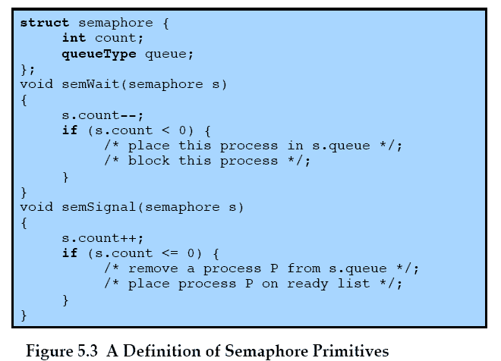
SEMAPHORE
Notes:
An example of a semaphore

Slide 10
Semaphore Example 1
semaphore s = 2;
P_{i} {
while(1) {
semWait(s);
/* CS */
semSignal(s);
/* remainder */
}
}
What happens?
When might this be desirable?

Slide 11
Semaphore Example 1
semaphore s = 2;
P_{i} {
while(1) {
semWait(s);
/* CS */
semSignal(s);
/* remainder */
}
}
What happens?
When might this be desirable?
×
×
×
s = 2
1
0
-1

Slide 12
Semaphore Example 1
semaphore s = 2;
P_{i} {
while(1) {
semWait(s);
/* CS */
semSignal(s);
/* remainder */
}
}
What happens?
Allows up to 2 processes to enter CS
When might this be desirable?
Need up to 2 processes inside CS
e.g., limit number of processes reading a var
Be careful not to violate mutual exclusion inside CS!

Slide 13
Semaphore Example 2
semaphore s = 0;
P_{i} {
while(1) {
semWait(s);
/* CS */
semSignal(s);
/* remainder */
}
}
What happens?
When might this be desirable?

Slide 14
Semaphore Example 2
semaphore s = 0;
P_{i} {
while(1) {
semWait(s);
/* CS */
semSignal(s);
/* remainder */
}
}
What happens?
When might this be desirable?
×
×
×
s = 0
-1
-2
-3

Slide 15
Semaphore Example 2
semaphore s = 0;
P_{i} {
while(1) {
semWait(s);
/* CS */
semSignal(s);
/* remainder */
}
}
What happens?
No one can enter CS! Ever!
When might this be desirable?
Never!

Slide 16
Binary Semaphore
A more restrictive semaphore which may only have the value of 0 or 1
A binary semaphore may be initialized to 0 or 1.
2. The semWaitB operation checks the semaphore value. If the value is zero, then
the Process executing the semWaitB is blocked. If the value is one, then the value
is Changed to zero and the process continues execution.
3. The semSignalB operation checks to see if any processes are blocked on this
semaphore (semaphore value equals zero).
If so, then a process blocked by a semWaitB operation is unblocked.
If no processes are blocked, then the value of the semaphore is set to one.
To contrast the two types of semaphores, the nonbinary semaphore is often
referred to as either a counting semaphore or a general semaphore.

Slide 17
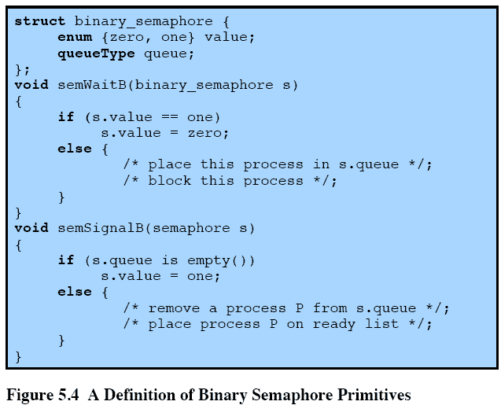
Binary Semaphore Primitives (locks & mutex)
Notes:
A more restrictive semaphore which may only have the value of 0 or 1
A similar concept related to the binary semaphore is the mutex.
A key difference between the two is that the process that locks the mutex (sets the value to zero) must be the one to unlock it (sets the value to 1).
In contrast, it is possible for one process to lock a binary semaphore and for another to unlock it.

Slide 18
Strong Semaphore Vs. Weak Semaphore
It is important to decide the order in which processes are removed from a blocked queue.
The fairest removal policy is first-in-first-out (FIFO):
The process that has been blocked the longest is released from the queue first; a semaphore follows this policy is called a strong semaphore.
A semaphore that does not specify the order in which processes are removed from the queue is a weak semaphore.
Strong semaphores guarantee freedom from starvation, while
Weak semaphores do not guarantee freedom from starvation.
Strong semaphores are more convenient because this is the form of semaphore typically provided by operating systems.
Weak semaphores are not convenient as strong semaphores.

Slide 19
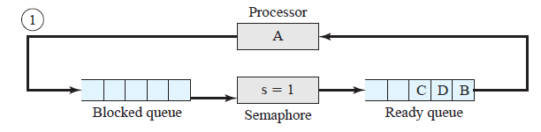
Example of Strong Semaphore Mechanism
Initially (1), A is running;
B, C, and D are ready;
The semaphore count is 1, indicating that one of D’s results is available.
That means up to 1 process can enter critical section.
When A issues a semWait instruction on semaphore s, the semaphore decrements
to 0, and A can continue to execute;
Subsequently it rejoins the ready queue.

Slide 20
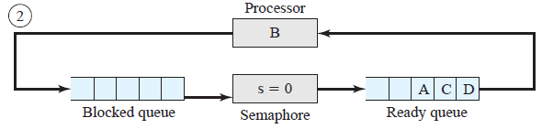
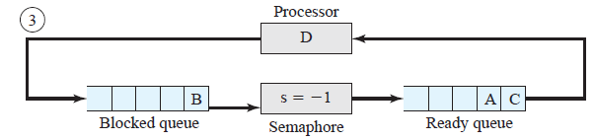
Then B runs, eventually issues a semWait instruction, and is blocked,
allowing D to run (3).

Slide 21
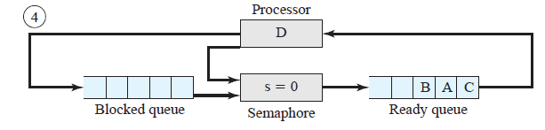
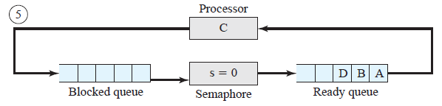
(4) When D completes a new result, it issues a semSignal instruction, which
allows B to move to the ready queue.
(5) D rejoins the ready queue and C begins to run but is blocked when it
issues a semWait instruction.

Slide 22
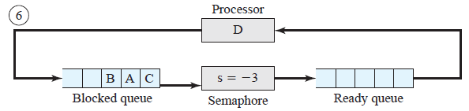
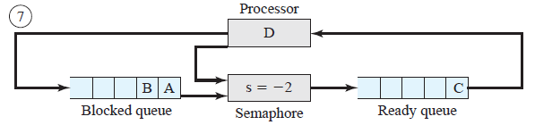
Similarly, A and B run and are blocked on the semaphore, allowing D to resume execution (6)
When D has a result, it issues a semSignal, which transfers C to the ready queue. Later cycles of D will release A and B from the Blocked state.

Slide 23
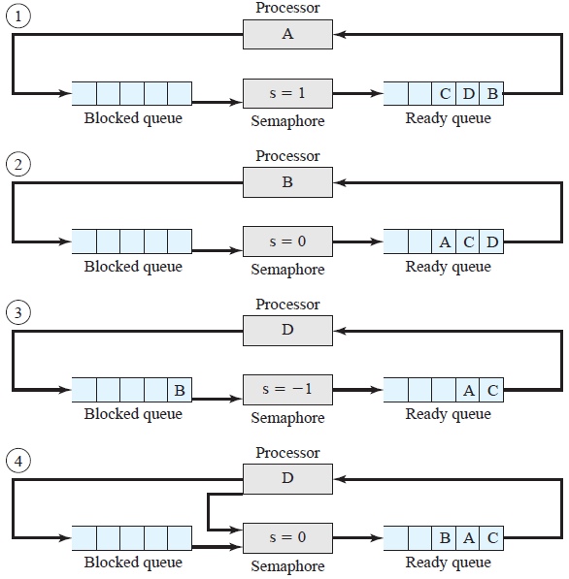
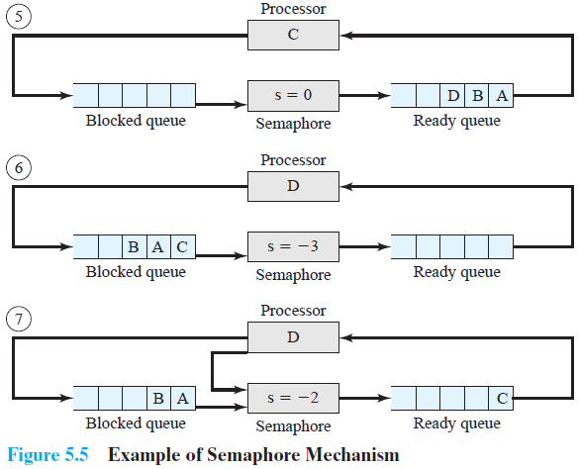

Slide 24
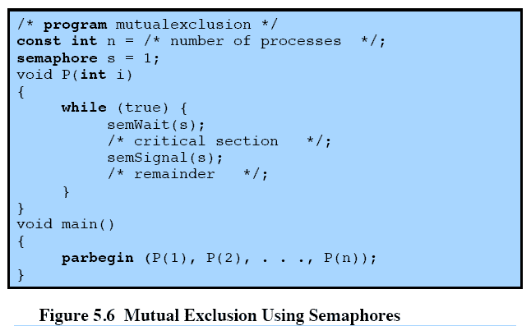
Mutual Exclusion Using Semaphore

Slide 25
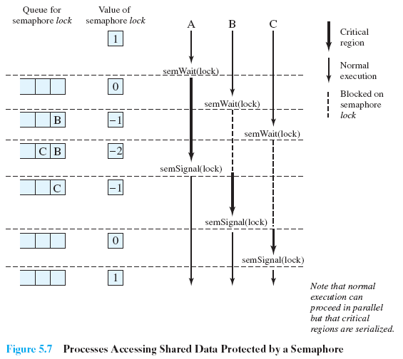
Processes Accessing Shared Data Protected by a Semaphore
Notes:
Figure 5.7, shows a possible sequence for three processes using the mutual exclusion discipline of Figure 5.6.
Three processes (A,B, C) access a shared resource protected by the semaphore lock.
Process-A executes semWait(lock);
because the semaphore has a value of 1 at the time of the semWait operation, A can immediately enter its critical section and the semaphore takes on the value 0.
While A is in its critical section, both B and C perform a semWait operation and are blocked pending the availability of the semaphore.
When A exits its critical section and performs semSignal(lock), B, which was the first process in the queue, can now enter its critical section.

Slide 26
ROADMAP - Concurrency
Key terms
Principles of concurrency :
Requirement of mutual exclusion
Semaphores
Producer Consumer Problem
Readers- Writers Problem

Slide 27
Producer/Consumer Problem
We now examine one of the most common problems faced in concurrent
processing: the producer/consumer problem
The general statement is this:
There are one or more producers generating some type of data and placing
these in a buffer.
There is a single consumer that is taking items out of the buffer one at a time.
The system is to be constrained to prevent the overlap of buffer operations.
That is, only one agent (producer or consumer) may access the buffer at any
one time.
The Problem:
Ensure that the Producer can’t add data into full buffer and consumer can’t remove data
from empty buffer
We will look at a number of solutions to this problem to illustrate both the power
and the pitfalls of semaphores.

Slide 28
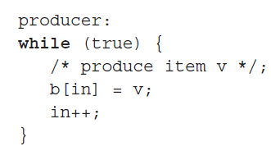
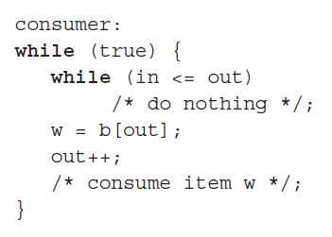
Producer/Consumer Problem
Assume an infinite buffer b with a linear array of elements
In = last , out = first

Slide 29
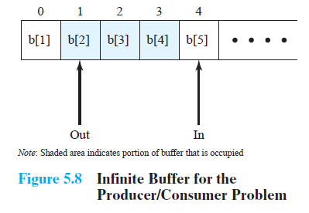
Buffer
The producer can generate items and store them in the buffer at its own pace.
Each time, an index (in) into the buffer is incremented.
The consumer proceeds in a similar fashion but must make sure that it does not
attempt to read from an empty buffer.
Hence, consumer makes sure that the producer has advanced beyond it
(in > out) before proceeding.
Notes:
The producer can generate items and store them in the buffer at its own pace.
Each time, an index (in) into the buffer is incremented.
The consumer proceeds in a similar fashion but must make sure that it does not attempt to read from an empty buffer.

Slide 30
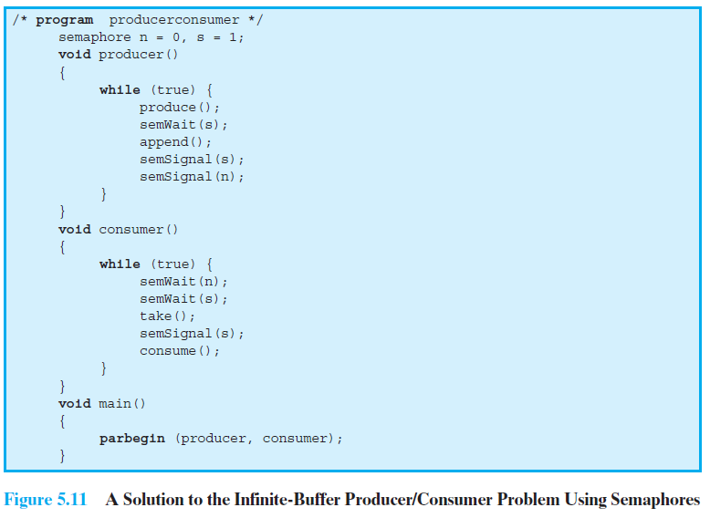
Solution Using semaphores
Notes:
A somewhat cleaner solution can be obtained if general semaphores (also called counting semaphores) are used
The variable n is now a semaphore.
Its value still is equal to the number of items in the buffer.
Suppose now that in transcribing this program, a mistake is made and the operations semSignal(s) and semSignal(n) are interchanged.
This would require that the semSignal(n) operation be performed in the producer’s critical section without interruption by the consumer or another producer.
Would this affect the program?
No, because the consumer must wait on both semaphores before proceeding in any case.

Slide 31
Solution Using semaphores
A somewhat cleaner solution can be obtained if general semaphores (also called counting semaphores) are used.
The variable n is now a semaphore.
Its value still is equal to the number of items in the buffer.
Suppose now that in transcribing this program, a mistake is made and the operations semSignal(s) and semSignal(n) are interchanged.
This would require that the semSignal(n) operation be performed in the producer’s critical section without interruption by the consumer or another producer.
Would this affect the program?
No, because the consumer must wait on both semaphores before proceeding in any case.
Problem is:
Suppose that the semWait(n) and semWait(s) operations are accidentally reversed.
This means if the consumer ever enters its critical section when the buffer is empty (n.count = 0), then no producer can ever append to the buffer and the system is deadlocked.

Slide 32
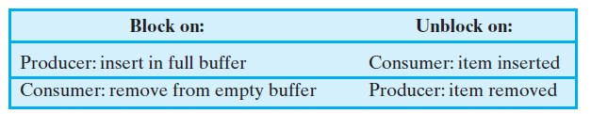
Finite Circular Buffer / Bounded Buffer
Finally, let us add a new and realistic restriction to the producer/consumer problem:
namely, that the buffer is finite.
The buffer is treated as a circular storage (Figure 5.12), and pointer values must be expressed modulo the size of the buffer.
The following relationships hold:

Slide 33
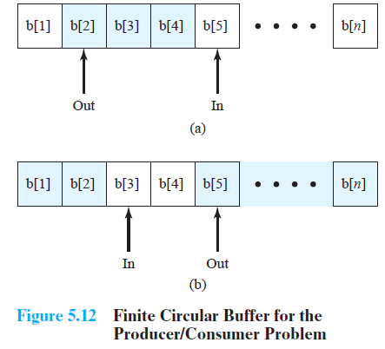
Finite Circular Buffer / Bounded Buffer

Slide 34
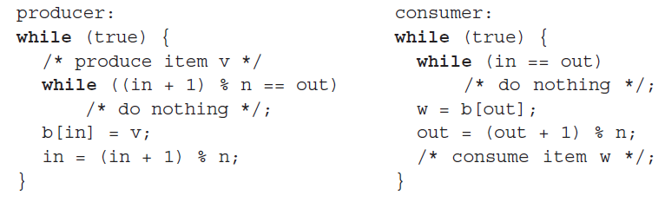
Finite Circular Buffer / Bounded Buffer
The producer and consumer functions can be expressed as follows (variable in and out are initialized to 0 and n is the size of the buffer):
Figure 5.13 shows a solution using general semaphores. The semaphore e has
been added to keep track of the number of empty spaces.

Slide 35
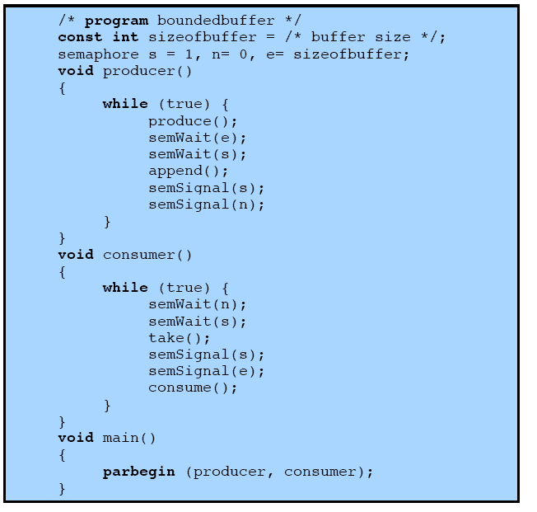
Semaphores
Figure 5.13 A Solution to the Bounded-Buffer Producer/Consumer Problem Using Semaphores

Slide 36
ROADMAP - Concurrency
Key terms
Principles of concurrency :
Requirement of mutual exclusion
Semaphores
Producer Consumer Problem
Readers- Writers Problem

Slide 37
Reader / Writer Problem
The readers/writers problem is:
There is a data area shared among a number of processes.
The data area could be a file, a block of main memory, or even a bank of processor registers.
There are a number of processes that only read the data area (readers) and a number that only write to the data area (writers).
The conditions that must be satisfied are as follows:
1. Any number of readers may simultaneously read the file.
2. Only one writer at a time may write to the file.
3. If a writer is writing to the file, no reader may read it.

Slide 38
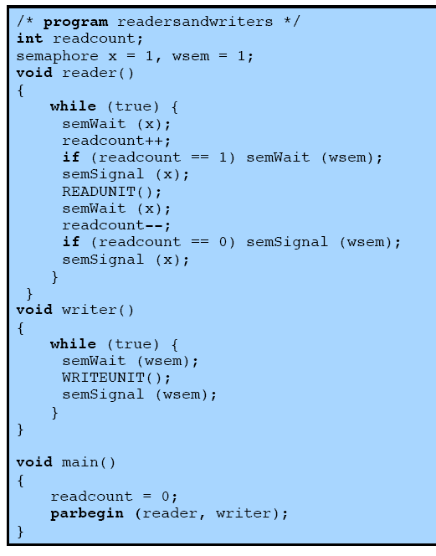
Readers have Priority
Reader / Writer Problem Using Semaphore
Fig 5.22 A Solution to the Readers/Writers Problem Using Semaphore: Readers Have Priority
Notes:
This solution uses semaphores, showing one instance each of a reader and a writer; the solution does not change for multiple readers and writers.
Once a single reader has begun to access the data area, it is possible for readers to retain control of the data area as long as there is at least one reader in the act of reading.
Therefore, writers are subject to starvation.

Slide 39
Readers have Priority
Fig 5.22 This solution uses semaphores, showing one instance each of a reader and a
writer; the solution does not change for multiple readers and writers.
The semaphore wsem is used to enforce mutual exclusion.
As long as one writer is accessing the shared data area, no other writers and no
readers may access it.
The reader process also makes use of wsem to enforce mutual exclusion.
However, to allow multiple readers, we require that, when there are no readers reading, the first reader that attempts to read should wait on wsem.
When there is already at least one reader reading, subsequent readers need not
wait before entering.
The global variable readcount is used to keep track of the number of readers, and the semaphore x is used to assure that readcount is updated properly.
Once a single reader has begun to access the data area, it is possible for readers to retain control of the data area as long as there is at least one reader in the act of reading.
Therefore, writers are subject to starvation.

Slide 40
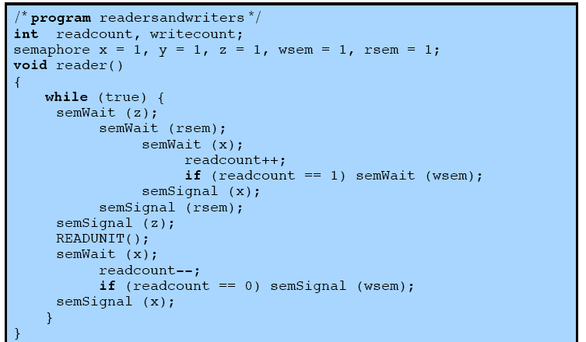
Writers have Priority
Contd…
This solution guarantees that no new readers are allowed access to the data area once at least one writer has declared a desire to write.

Slide 41
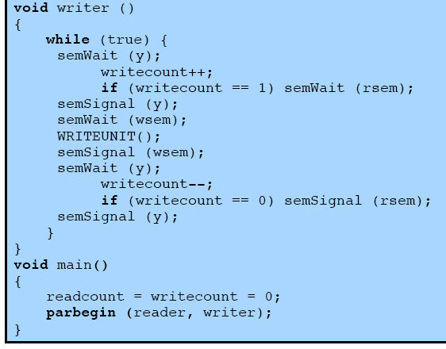
Contd…
Fig 5.23 A Solution to the Readers/Writers Problem Using Semaphore: Writers Have Priority

Slide 42
Writers have Priority
In Fig 5.22 Once a single reader has begun to access the data area, it is possible for
readers to retain control of the data area as long as there is at least one reader in the act of reading.
Therefore, writers are subject to starvation.
Figure 5.23 shows a solution that guarantees that no new readers are allowed access
to the data area once at least one writer has declared a desire to write.
For writers, the following semaphores and variables are added to the ones already
defined:
• A semaphore rsem that inhibits all readers while there is at least one writer
desiring access to the data area.
• A variable writecount that controls the setting of rsem.
• A semaphore y that controls the updating of writecount.
Only one reader is allowed to queue on rsem, with any additional readers queuing
on semaphore z, immediately before waiting on rsem.
Table 5.6 summarizes the possibilities.

Slide 43
ROADMAP - Deadlock
Principles of Deadlock
Deadlock Prevention
Deadlock Avoidance
Deadlock Detection
Dinning philosophers problem: Solution using semaphores

Slide 44
Deadlock
A set of processes is deadlocked when each process in the set is blocked awaiting an event that can only be triggered by another blocked process in the set
typically processes are waiting the freeing up of some requested resource.
Deadlock is permanent because none of the events is ever triggered.
Unlike other problems in concurrent process management, there is no efficient solution in the general case.

Slide 45

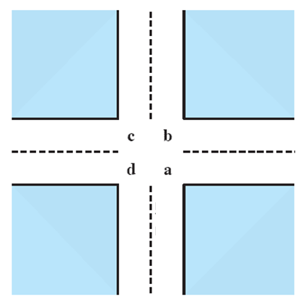
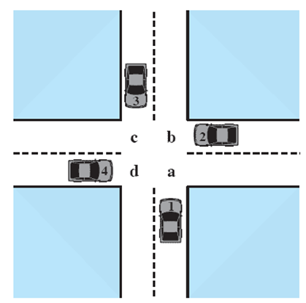



Potential Deadlock
I need quad C and D
I need quad B and C
I need quad A and B
I need quad D and A
Notes:
Animated Slide
Click 1 Cars approach intersection
Then Cars announce their resource needs
All deadlocks involve conflicting needs for resources by two or more processes. A common example is the traffic deadlock.
The typical rule of the road in the United States is that a car at a four-way stop should defer to a car immediately to its right.
This rule works if there are only two or three cars at the intersection.
If all four cars arrive at about the same time, each will refrain from entering the intersection, this causes a potential deadlock.
The deadlock is only potential, not actual, because the necessary resources are available for any of the cars to proceed.
If one car eventually does proceed, it can do so.

Slide 46

Potential Deadlock
All deadlocks involve conflicting needs for resources by two or more processes. A common example is the traffic deadlock.
The typical rule of the road in the United States is that a car at a four-way stop should defer to a car immediately to its right.
This rule works if there are only two or three cars at the intersection.
If all four cars arrive at about the same time, each will refrain from entering the intersection, this causes a potential deadlock.
The deadlock is only potential, not actual, because the necessary resources are available for any of the cars to proceed.
If one car eventually does proceed, it can do so.

Slide 47
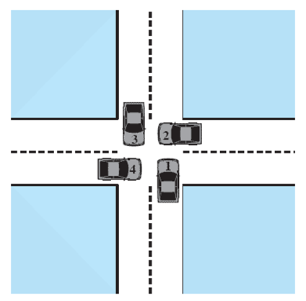
Actual Deadlock
HALT until D is free
HALT until C is free
HALT until B is free
HALT until A is free
Notes:
Animated Slide
Click 1 Cars move to deadlock
Then Cars announce their resource need
But if all four cars ignore the rules and proceed (cautiously) into the intersection at the same time, then each car seizes one resource (one quadrant) but cannot proceed because the required second resource has already been seized by another car.
This is an actual deadlock.

Slide 48
Actual Deadlock
But if all four cars ignore the rules and proceed (cautiously) into the intersection at the same time, then each car seizes one resource (one quadrant) but cannot proceed because the required second resource has already been seized by another car.
This is an actual deadlock.

Slide 49
Conditions for possible Deadlock
(1) Mutual exclusion:-
Only one process may use a resource at a time.
No process may access a resource unit that has been allocated to another process.
(2)Hold-and-wait:-
A process may hold allocated resources while awaiting assignment of other resources.
(3)No pre-emption:-
No resource can be forcibly removed form a process holding it.
In many ways these conditions are quite desirable.
For example, mutual exclusion is needed to ensure consistency of results and the integrity of a database.
Similarly, preemption should not be done arbitrarily.
For example, when data resources are involved, preemption must be supported by a rollback recovery mechanism.
All three must be present for deadlock to occur.
Notes:
All three must be present for deadlock to occur.

Slide 50
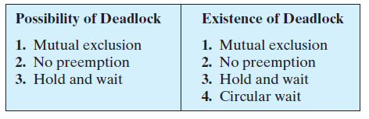
Actual Deadlock Requires …
All previous 3 conditions plus:
(4) Circular wait:-
A closed chain of processes exists, such that each process holds at least one resource needed by the next process in the chain.
This is actually a potential consequence of the first three.
Given that the first three conditions exist, a sequence of events may occur that lead to an unresolvable circular wait.
The unresolvable circular wait is in fact the definition of deadlock.
The circular wait listed as condition 4 is unresolvable because the first three conditions hold.
Thus, the four conditions, taken together, constitute necessary and sufficient conditions for deadlock.
Notes:
This is actually a potential consequence of the first three.
Given that the first three conditions exist, a sequence of events may occur that lead to an unresolvable circular wait.
The unresolvable circular wait is in fact the definition of deadlock.
The circular wait listed as condition 4 is unresolvable because the first three conditions hold.
Thus, the four conditions, taken together, constitute necessary and sufficient conditions for deadlock.

Slide 51
ROADMAP - Deadlock
Principles of Deadlock
Deadlock Prevention
Deadlock Avoidance
Deadlock Detection
Dinning philosophers problem: Solution using semaphores

Slide 52
Deadlock prevention Staregy
Deadlock prevention is strategy simply to design a system in such a way that the
possibility of deadlock is excluded.
We can view deadlock prevention methods as falling into two classes.
Indirect method of deadlock prevention is to prevent the occurrence of one of
the three necessary conditions listed previously (items 1 through 3).
Direct method of deadlock prevention is to prevent the occurrence of a circular
wait (item 4).
We now examine techniques related to each of the four conditions.
Deadlock prevention Conditions 1 & 2
(1) Mutual Exclusion:-
The first of the four listed conditions cannot be disallowed (in general).
If access to a resource requires mutual exclusion, then mutual exclusion must be supported by the OS.
Some resources, such as files, may allow multiple accesses for reads but only exclusive access for writes.
Even in this case, deadlock can occur if more than one process requires write permission.

Slide 53
Deadlock prevention Conditions 1 & 2
(2) Hold and Wait:-
Can be prevented by requiring that a process request all of its required resources at one time and blocking the process until all requests can be granted simultaneously.
This approach is inefficient in two ways.
1) a process may be held up for a long time waiting for all of its resource requests to be filled, when in fact it could have proceeded with only some of the resources.
resources allocated to a process may remain unused for a considerable period, during which time they are denied to other processes.
Another problem is that a process may not know in advance all of the resources that it will require.
There is also the practical problem created by the use of modular programming or a multithreaded structure for an application.
An application would need to be aware of all resources that will be requested at all levels or in all modules to make the simultaneous request.

Slide 54
Deadlock prevention Conditions 3 & 4
(3)No Preemption:-
can be prevented in several ways.
If a process holding certain resources is denied a further request, that process must release its original resources and, if necessary, request them again together with the additional resource.
If a process requests a resource that is currently held by another process, the OS may preempt the second process and require it to release its resources.
This latter scheme would prevent deadlock only if no two processes possessed the same priority.
This approach is practical only with resources whose state can be easily saved and restored later, as is the case with a processor.
(4)Circular Wait:-
Can be prevented by defining a linear ordering of resource types.
As with hold-and-wait prevention, circular-wait prevention may be inefficient, slowing down processes and denying resource access unnecessarily.

Slide 55
ROADMAP - Deadlock
Principles of Deadlock
Deadlock Prevention
Deadlock Avoidance
Deadlock Detection
Dinning philosophers problem: Solution using semaphores

Slide 56
Deadlock Avoidance
Deadlock avoidance is a method used in computer systems to ensure that processes do not enter into a deadlock situation. Instead of just setting rules like in deadlock prevention, deadlock avoidance continuously monitors the state of the system and makes decisions on-the-fly to keep processes from getting stuck.

Slide 57
Deadlock Avoidance
Deadlock avoidance ensures that a resource request is only granted if it won’t lead to deadlock, either immediately or in the future. Since the kernel can’t predict future process behavior, it uses a conservative approach. Each process declares the maximum number of resources it may need. The kernel allows requests in stages, checking for potential deadlocks before granting them. A request is granted only if no deadlock is possible; otherwise, it stays pending. This approach is conservative, as a process may finish without using the maximum resources it declared.
Banker’s Algorithm is the technique used for Deadlock Avoidance.

Slide 58
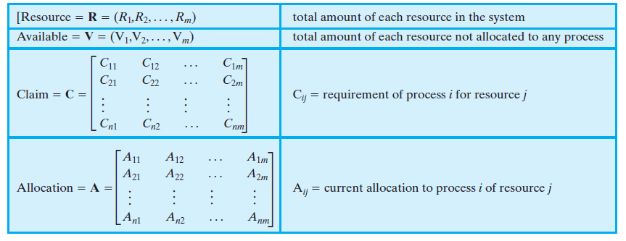
Consider a system of n processes and m different types of resources. Let us define the following vectors and matrices:
Data Structures:-

Slide 59
Deadlock Avoidance
Banker’s Algorithm:
Bankers’ Algorithm is a resource allocation and deadlock avoidance algorithm that tests all resource requests made by processes. It checks for the safe state, and if granting a request keeps the system in safe state, the request is allowed. However, if no safe state exists, the request is denied.
Inputs to Banker’s Algorithm:
Max needs of resources by each process.
Currently, allocated resources by each process.
Max free available resources in the system.
The request will only be granted under the below condition:
If the request made by the process is less than equal to the max needed for that process.
If the request made by the process is less than equal to the freely available resource in the system.

Slide 60
Deadlock Avoidance
A real-life example of a deadlock avoidance algorithm in action is the Banker's Algorithm, which is used in banking systems to determine whether a loan can be granted without jeopardizing the bank's ability to fulfill all customer withdrawals.
The Problem:
Imagine a bank with a limited amount of money (resources) and multiple customers (processes) who want to borrow money (request resources). If the bank grants loans without considering the potential for all customers to withdraw their money, it could lead to a "deadlock" where no one can get their money back.

Slide 61
Deadlock Avoidance
The Banker's Algorithm:
The Banker's Algorithm works by simulating resource allocation requests and determining if granting a request would lead to a "safe state" where all processes (customers) can complete their operations (withdraw their money).
How it Works:
The bank keeps track of the total amount of money it has and the amount each customer has in their account.
When a customer requests a loan, the bank simulates the loan request by subtracting the loan amount from the bank's total.
The bank then checks if, after granting the loan, there's enough money remaining to satisfy all customer withdrawals, even if they all happen simultaneously.
If there's enough money, the loan is granted, and the bank remains in a safe state. If not, the loan is denied to avoid a potential deadlock.
In essence, the Banker's Algorithm ensures that the bank never allocates its resources in a way that it cannot fulfill the needs of all its customers, thus avoiding a deadlock situation.

Slide 62
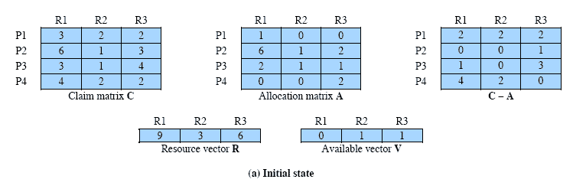
Determination of Safe State
A system consisting of four processes and three resources.
Allocations are made to processors
Is this a safe state?
Resources available after allocation
Amount of Existing Resources
This figure shows the state of a system consisting of four processes and three
resources.
Total amount of resources
R1 = 9 R2 = 3 R3 = 6
Notes:
Animation: Callouts explain resource parts of figure
This figure shows the state of a system consisting of four processes and three resources.
Total amount of resources
R1 = 9
R2 = 3
R3 = 6
In the current state allocations have been made to the four processes, leaving available
1 unit of R2
1 unit of R3
Is this a safe state?
To answer this question, we ask an intermediate question:
Can any of the four processes be run to completion with the resources available?
That is, can the difference between the maximum requirement and current allocation for any process be met with the available resources?

Slide 63
Determination of Safe State
In the current state allocations have been made to the four processes, leaving available 1 unit of R2 and 1 unit of R3
Is this a safe state?
To answer this question, we ask an intermediate question:
Can any of the four processes be run to completion with the resources available?
That is, can the difference between the maximum requirement and current allocation for any process be met with the available resources?
C_{ij} - A_{ij} ≤ V_{j}, for all j
This is not possible for P1,
which has only 1 unit of R1 and requires 2 more units of R1, 2 units of R2, and 2 units of R3.
If we assign one unit of R3 to process P2,
Then P2 has its maximum required resources allocated and can run to completion and return resources to ‘available’ pool.
The resulting state is shown in Figure 6.7b.

Slide 64
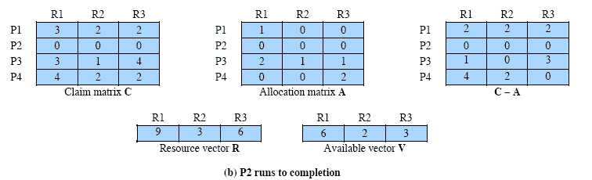
After P2 runs to completion
Can any of the remaining processes can be completed?
In this case, each of the remaining processes could be completed as shown on the next slides.
Note P2 is completed
Notes:
In this case, each of the remaining processes could be completed as shown on the next slides

Slide 65
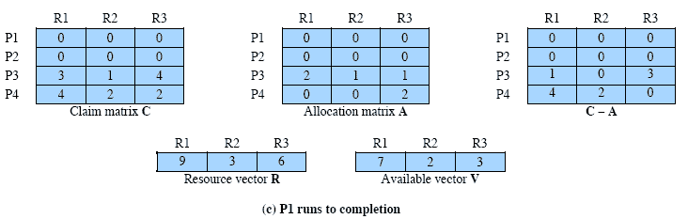
After P1 completes
Suppose we choose P1,
allocate the required resources,
complete P1,
and return all of P1’s resources to the available pool.
We are left in the state shown in Figure 6.7c on this slide
Notes:
Suppose we choose P1,
allocate the required resources,
complete P1,
and return all of P1’s resources to the available pool.
We are left in the state shown in Figure 6.7c on this slide

Slide 66
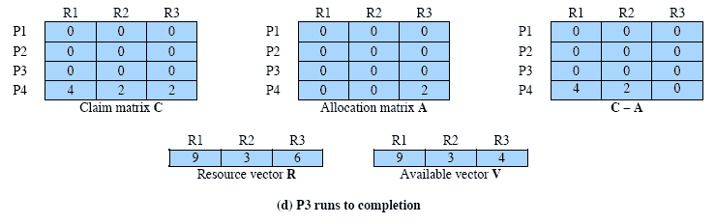
P3 Completes
P3 completes, resulting in the state of Figure 6.7d shown on this slide
Finally, we can complete P4. At this point, all of the processes have been run to completion.
Thus, the state defined by Figure 6.7a is a safe state.
Thus, the state defined originally is a safe state.
Notes:
P3 completes, resulting in the state of Figure 6.7d shown on this slide
Finally, we can complete P4. At this point, all of the processes have been run to completion.
Thus, the state defined by Figure 6.7a is a safe state.

Slide 67
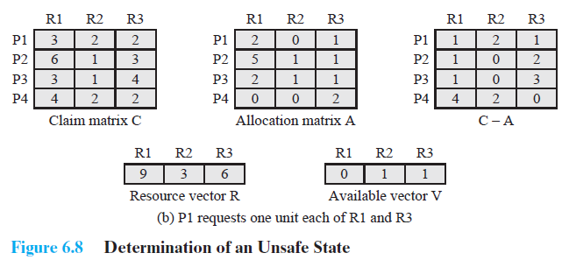
Determination of an Unsafe State
This is not a deadlocked state. It merely has the potential for deadlock.
It is possible, for example, that if P1 were run from this state it would
subsequently release one unit of R1 and one unit of R3 prior to
needing these resources again.
If that happened, the system would return to a safe state.
Thus, the deadlock avoidance strategy does not predict deadlock
with certainty; it merely anticipates the possibility of deadlock and
assures that there is never such a possibility.
This time Suppose that P1 makes the request for one additional unit each of R1 and R3.
Is this safe?

Slide 68
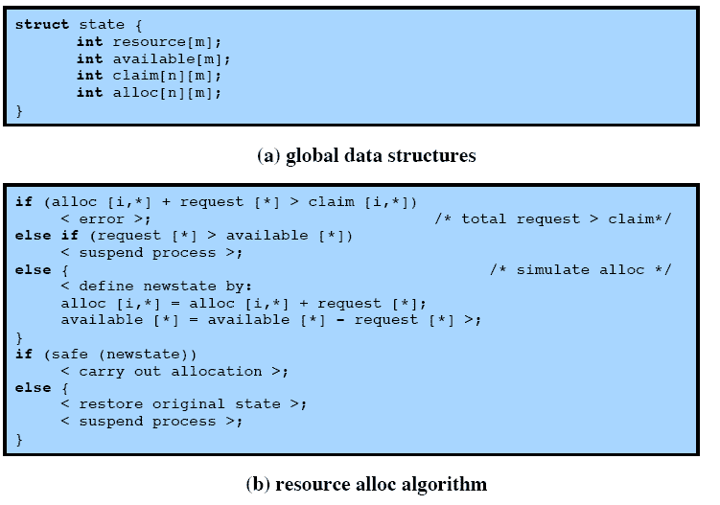
Deadlock Avoidance Logic
Notes:
This slide gives an abstract version of the deadlock avoidance logic.
The main algorithm is shown in part (b).
With the state of the system defined by the data structure state, request[*] is a vector defining the resources requested by process i.
First, a check is made to assure that the request does not exceed the original claim of the process.
If the request is valid, the next step is to determine if it is possible to fulfill the request (i.e., there are sufficient resources available).
If it is not possible, then the process is suspended.
If it is possible, the final step is to determine if it is safe to fulfill the request. To do this, the resources are tentatively assigned to process i to form newstate.

Slide 69
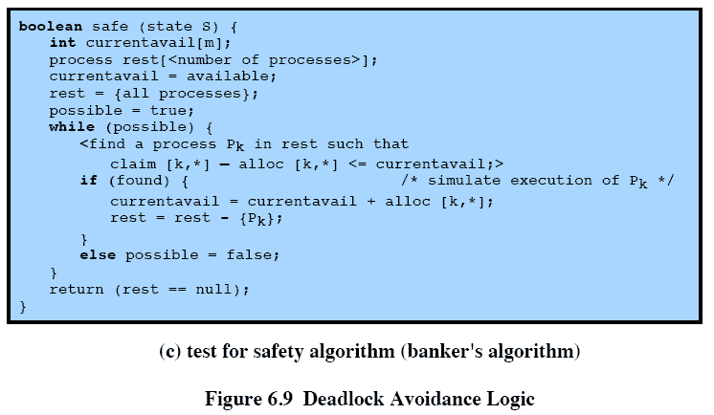
Deadlock Avoidance Logic
Notes:
Then a test for safety is made using the algorithm in Figure 6.9c.

Slide 70
Deadlock Avoidance Algorithm
1. Initialize the system
1. Define the number of processes and resource types.
2. Define the total number of available resources for each resource type.
3. Create a matrix called the "allocation matrix" to represent the current resource allocation for each process.
4. Create a matrix called the "need matrix" to represent the remaining resource needs for each process.
2. Define a request
A process requests a certain number of resources of a particular type.
3. Check if the request can be granted
1. Check if the requested resources are available.
2. If the requested resources are not available, the process must wait.
3. If the requested resources are available, go to the next step.
Notes:
This suggests the following deadlock avoidance strategy,
which ensures that the system of processes and resources is always in a safe state.
When a process makes a request for a set of resources, assume that the request is granted, update
the system state accordingly, and then determine if the result is a safe state. If so,
grant the request and, if not, block the process until it is safe to grant the request.

Slide 71
Deadlock Avoidance Algorithm
4. Check if the system is in a safe state
1. Simulate the allocation of the requested resources to the process.
2. Check if this allocation results in a safe state, meaning there is a sequence of allocations that can satisfy all processes without leading to a deadlock.
3. If the state is safe, grant the request by updating the allocation matrix and the need matrix.
4. If the state is not safe, do not grant the request and let the process wait.
5. Release the Resources
When a process has finished its execution, releases its allocated resources by updating the allocation matrix and the need matrix.
Notes:
This suggests the following deadlock avoidance strategy,
which ensures that the system of processes and resources is always in a safe state.
When a process makes a request for a set of resources, assume that the request is granted, update
the system state accordingly, and then determine if the result is a safe state. If so,
grant the request and, if not, block the process until it is safe to grant the request.

Slide 72
Deadlock Avoidance Advantages
It is not necessary to preempt and rollback processes, as in deadlock detection,
It is less restrictive than deadlock prevention.
Deadlock Avoidance Restrictions
However, it does have a number of restrictions on its use
Maximum resource requirement must be stated in advance
Processes under consideration must be independent and with no synchronization requirements
There must be a fixed number of resources to allocate
No process may exit while holding resources
Notes:
Deadlock avoidance has the advantage that it is not necessary to preempt and
rollback processes, as in deadlock detection, and is less restrictive than deadlock
prevention.

Slide 73
ROADMAP - Deadlock
Principles of Deadlock
Deadlock Prevention
Deadlock Avoidance
Deadlock Detection
Dinning philosophers problem: Solution using semaphores

Slide 74
Deadlock Detection
Deadlock prevention strategies are very conservative;
limit access to resources and impose restrictions on processes.
Deadlock detection strategies do the opposite
Resource requests are granted whenever possible.
Periodically, the OS performs an algorithm that allows it to detect the circular wait condition
Deadlock Detection Algorithm
A check for deadlock can be made as frequently as each resource request.
Checking at each resource request has two advantages:
It leads to early detection,
The algorithm is relatively simple because it is based on incremental changes to
the state of the system.
On the other hand, such frequent checks consume considerable processor time.
Notes:
Deadlock checks can be made as frequently as each resource request or, less frequently, depending on how likely it is for a deadlock to occur.
Checking at each resource request has two advantages:
it leads to early detection,
the algorithm is relatively simple because it is based on incremental changes to the state of the system.
On the other hand, such frequent checks consume considerable processor time.

Slide 75
A Common Detection Algorithm
Use a Allocation matrix and Available vector as previous
Also use a request matrix Q
Where Qij indicates that an amount of resource j is requested by process I
First ‘un-mark’ all processes that are not deadlocked
Initially all processes are unmarked.
Steps for Detection Algorithm:-
Mark each process that has a row in the Allocation matrix of all zeros.
2. Initialize a temporary vector W to equal the Available vector.
3. Find an index i such that process i is currently unmarked and the ith row of Q is
less than or equal to W. That is, Qik <=Wk, for 1 <= k<= m. If no such row is found,
terminate the algorithm.
4. If such a row is found, mark process i and add the corresponding row of the
allocation matrix to W. That is, set Wk = Wk + Aik, for for 1 <= k<= m.
Return to step 3.
Notes:
A common algorithm for deadlock detection is one described in [COFF71].
The Allocation matrix and Available vector described in the previous section are used.
In addition, a request matrix Q is defined such that Qij represents the amount of resources of type j requested by process i.
The algorithm proceeds by marking processes that are not deadlocked. Initially, all processes are unmarked.

Slide 76
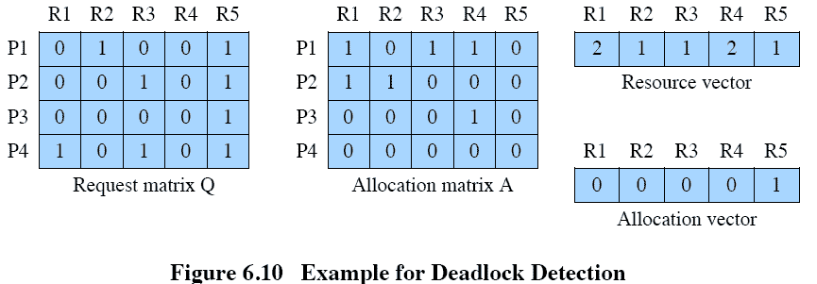
Deadlock Detection
Notes:
1. Mark P4, because P4 has no allocated resources.
2. Set W = (0 0 0 0 1).
3. The request of process P3 is less than or equal to W, so mark P3 and set W=W + (0 0 0 1 0) = (0 0 0 1 1).
4. No other unmarked process has a row in Q that is less than or equal to W.
Therefore, terminate the algorithm.
The algorithm concludes with P1 and P2 unmarked, indicating that these processes are deadlocked.

Slide 77
Recovery Strategies Once Deadlock Detected
Deadlock Detection
1. Mark P4, because P4 has no allocated resources.
2. Set W = (0 0 0 0 1).
3. The request of process P3 is less than or equal to W, so mark P3 and set W=W + (0 0 0 1 0) = (0 0 0 1 1).
4. No other unmarked process has a row in Q that is less than or equal to W.
Therefore, terminate the algorithm.
The algorithm concludes with P1 and P2 unmarked, indicating that these processes are deadlocked.
Abort all deadlocked processes
Back up each deadlocked process to some previously defined checkpoint, and restart all process
Risk or deadlock recurring
Successively abort deadlocked processes until deadlock no longer exists
Successively preempt resources until deadlock no longer exists

Slide 78
Deadlock Detection
Deadlock detection is the process of identifying when processes are stuck waiting for resources held by other processes.
Detection is done using techniques like Resource Allocation Graphs (RAG) or Wait-for Graphs.
Recovery is the method of resolving the deadlock to allow the system to continue functioning.
Once a deadlock is detected, recovery methods include process termination, resource preemption, or process rollback.
Deadlock detection and recovery is an important aspect of operating system design and management, as it affects the stability and performance of the system.
Difference Between Prevention and Detection/Recovery:
Prevention aims to avoid deadlocks altogether by carefully managing resource allocation, while detection and recovery aim to identify and resolve deadlocks that have already occurred.
Notes:
A common algorithm for deadlock detection is one described in [COFF71].
The Allocation matrix and Available vector described in the previous section are used.
In addition, a request matrix Q is defined such that Qij represents the amount of resources of type j requested by process i.
The algorithm proceeds by marking processes that are not deadlocked. Initially, all processes are unmarked.

Slide 79
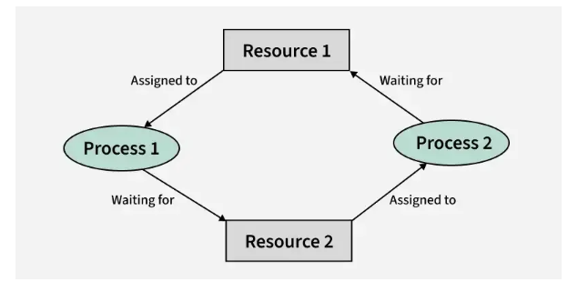
Deadlock Detection
Deadlock Detection
1. If Resources Have a Single Instance
In this case for Deadlock detection, we can run an algorithm to check for the cycle in the Resource Allocation Graph. The presence of a cycle in the graph is a sufficient condition for deadlock.
In the below diagram, resource 1 and resource 2 have single instances. There is a cycle R1 → P1 → R2 → P2. So, Deadlock is Confirmed.
Notes:
A common algorithm for deadlock detection is one described in [COFF71].
The Allocation matrix and Available vector described in the previous section are used.
In addition, a request matrix Q is defined such that Qij represents the amount of resources of type j requested by process i.
The algorithm proceeds by marking processes that are not deadlocked. Initially, all processes are unmarked.

Slide 80
Deadlock Detection
Wait-For Graph Algorithm:
The Wait-For Graph Algorithm is a deadlock detection algorithm used to detect deadlocks in a system where resources can have multiple instances. The algorithm works by constructing a Wait-For Graph, which is a directed graph that represents the dependencies between processes and resources.
Deadlocks are a fundamental problem in distributed systems. A process may request resources in any order and a process can request resources while holding others. A Deadlock is a situation where a set of processes are blocked as each process in a Distributed system is holding some resources and that acquired resources are needed by some other processes.
Example:
If there are three processes p1,p2 and p1 are acquiring r1 resource and that r1 is needed by p2 which is acquiring another resource r2 and that is needed by p1. Here cycle occurs. It is called a deadlock.
Notes:
A common algorithm for deadlock detection is one described in [COFF71].
The Allocation matrix and Available vector described in the previous section are used.
In addition, a request matrix Q is defined such that Qij represents the amount of resources of type j requested by process i.
The algorithm proceeds by marking processes that are not deadlocked. Initially, all processes are unmarked.

Slide 81
Deadlock Detection
Wait-For Graph:
.
Algorithm:
Step 1: Take the first process (Pi) from the resource allocation graph and check the path in which it is acquiring resource (R_{i}), and start a wait-for-graph with that particular process.
Step 2: Make a path for the Wait-for-Graph in which there will be no Resource included from the current process (P_{i}) to next process (P_{j}), from that next process (P_{j}) find a resource (R_{j}) that will be acquired by next Process (P_{k}) which is released from Process (P_{j}).
Step 3: Repeat Step 2 for all the processes.
Step 4: After completion of all processes, if we find a closed-loop cycle then the system is in a deadlock state, and deadlock is detected.
Notes:
A common algorithm for deadlock detection is one described in [COFF71].
The Allocation matrix and Available vector described in the previous section are used.
In addition, a request matrix Q is defined such that Qij represents the amount of resources of type j requested by process i.
The algorithm proceeds by marking processes that are not deadlocked. Initially, all processes are unmarked.

Slide 82
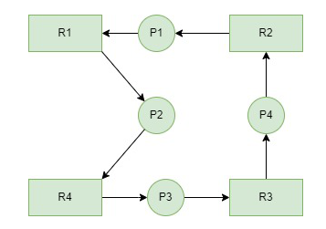
Deadlock Detection
Wait-For Graph Example:
.
Consider a Resource Allocation Graph with 4 Processes P1, P2, P3, P4, and 4 Resources R1, R2, R3, R4. Find if there is a deadlock in the Graph using the Wait for Graph-based deadlock detection algorithm.
Notes:
A common algorithm for deadlock detection is one described in [COFF71].
The Allocation matrix and Available vector described in the previous section are used.
In addition, a request matrix Q is defined such that Qij represents the amount of resources of type j requested by process i.
The algorithm proceeds by marking processes that are not deadlocked. Initially, all processes are unmarked.

Slide 83

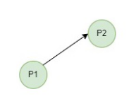
Deadlock Detection
Wait-For Graph Example:
.
Step 1: First take Process P1 which is waiting for Resource R1, resource R1 is acquired by Process P2, Start a Wait-for-Graph for the above Resource Allocation Graph.
Step 2: Now we can observe that there is a path from P1 to P2 as P1 is waiting for R1 which is been acquired by P2. Now the Graph would be after removing resource R1 looks like.
Notes:
A common algorithm for deadlock detection is one described in [COFF71].
The Allocation matrix and Available vector described in the previous section are used.
In addition, a request matrix Q is defined such that Qij represents the amount of resources of type j requested by process i.
The algorithm proceeds by marking processes that are not deadlocked. Initially, all processes are unmarked.

Slide 84
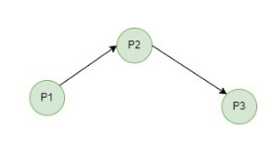
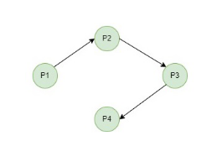
Deadlock Detection
Wait-For Graph Example:
.
Step 3: From P2 we can observe a path from P2 to P3 as P2 is waiting for R4 which is acquired by P3. So make a path from P2 to P3 after removing resource R4 looks like.
Step 4: From P3 we find a path to P4 as it is waiting for P3 which is acquired by P4. After removing R3 the graph looks like this.
Notes:
A common algorithm for deadlock detection is one described in [COFF71].
The Allocation matrix and Available vector described in the previous section are used.
In addition, a request matrix Q is defined such that Qij represents the amount of resources of type j requested by process i.
The algorithm proceeds by marking processes that are not deadlocked. Initially, all processes are unmarked.

Slide 85
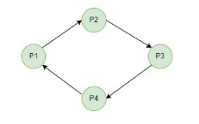
Deadlock Detection
Wait-For Graph Example:
.
Step 5: Here we can find Process P4 is waiting for R2 which is acquired by P1. So finally the Wait-for-Graph is as follows:
Step 6: Finally In this Graph, we found a cycle as the Process P4 again came back to the Process P1 which is the starting point (i.e., it’s a closed-loop). So, According to the Algorithm if we found a closed loop, then the system is in a deadlock state. So here we can say the system is in a deadlock state.
Notes:
A common algorithm for deadlock detection is one described in [COFF71].
The Allocation matrix and Available vector described in the previous section are used.
In addition, a request matrix Q is defined such that Qij represents the amount of resources of type j requested by process i.
The algorithm proceeds by marking processes that are not deadlocked. Initially, all processes are unmarked.

Slide 86
Deadlock Recovery
Deadlock Recovery:
Killing The Process: Killing all the processes involved in the deadlock. Killing process one by one. After killing each process check for deadlock again and keep repeating the process till the system recovers from deadlock. Killing all the processes one by one helps a system to break circular wait conditions.
Process Rollback: Rollback deadlocked processes to a previously saved state where the deadlock condition did not exist. It requires check pointing to periodically save the state of processes.
Resource Preemption: Resources are preempted from the processes involved in the deadlock, and preempted resources are allocated to other processes so that there is a possibility of recovering the system from the deadlock. In this case, the system goes into starvation.
.
Notes:
A common algorithm for deadlock detection is one described in [COFF71].
The Allocation matrix and Available vector described in the previous section are used.
In addition, a request matrix Q is defined such that Qij represents the amount of resources of type j requested by process i.
The algorithm proceeds by marking processes that are not deadlocked. Initially, all processes are unmarked.

Slide 87
ROADMAP - Deadlock
Principles of Deadlock
Deadlock Prevention
Deadlock Avoidance
Deadlock Detection
Dinning philosophers problem: Solution using semaphores

Slide 88
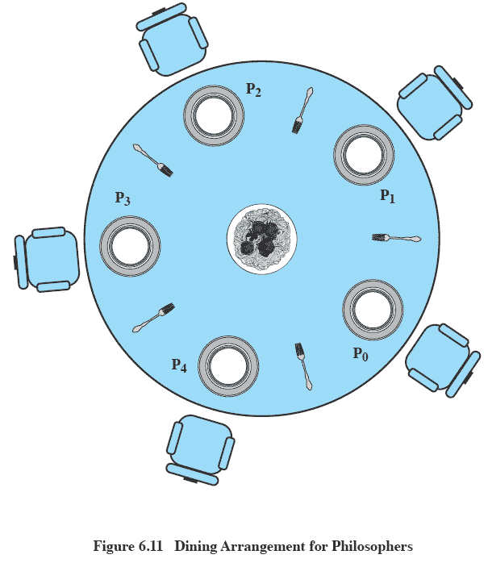
Dining Philosophers Problem: Scenario
Notes:
Five philosophers live in a house, where a table is laid for them.
The life of each philosopher consists principally of thinking and eating, and through years of thought, all of the philosophers had agreed that the only food that contributed to their thinking efforts was spaghetti.
Due to a lack of manual skill, each philosopher requires two forks to eat spaghetti.
A philosopher wishing to eat goes to his or her assigned place at the table and, using the two forks on either side of the plate, takes and eats some spaghetti.

Slide 89
The Problem
Dining Philosophers Problem: Scenario
Five philosophers live in a house, where a table is laid for them.
The life of each philosopher consists principally of thinking and eating, and through
years of thought, all of the philosophers had agreed that the only food that
contributed to their thinking efforts was spaghetti.
Due to a lack of manual skill, each philosopher requires two forks to eat spaghetti.
A philosopher wishing to eat goes to his or her assigned place at the table and, using
the two forks on either side of the plate, takes and eats some spaghetti.
Devise a ritual (algorithm) that will allow the philosophers to eat.
No two philosophers can use the same fork at the same time (mutual exclusion)
No philosopher must starve to death (avoid deadlock and starvation … literally!)

Slide 90
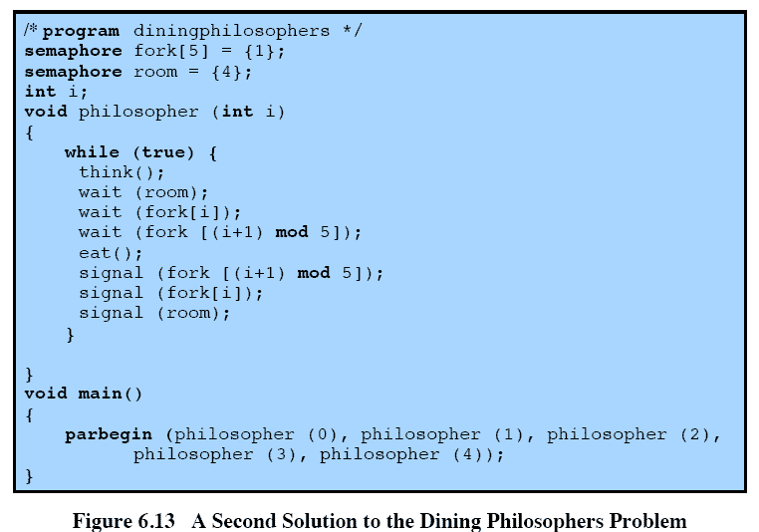
Avoiding deadlock
Notes:
We could consider adding an attendant who only allows four philosophers at a time into the dining room.
With at most four seated philosophers, at least one philosopher will have access to two forks.
This slide shows such a solution, again using semaphores. This solution is free of deadlock and starvation.

